Slide 1
Smart Watch
Derek Tan, Julian Nguyen, Eddie Ryan

Slide 2
Planned Functions
Bluetooth connectivity (Bluetooth mesh)
Accelerometer (gesture controls/wake up)
GPS (time correction, location, etc)
Vibration motor
Microphone/speaker
Screen display face
Push-button control

Slide 3
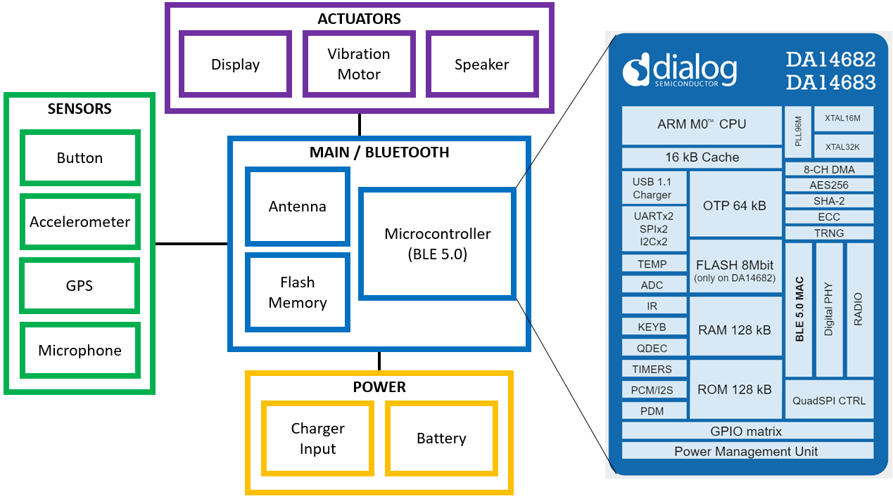
Basic Schematic

Slide 4
Potential Challenges
Form factor (wearable size)
Power management (battery, charging dock)
User Interface (iOS, Android)
Firmware
Professional enclosure (watch casing)

